Slide 1

WAKE FOREST UNIVERSITY
GRADUATE BUSINESS ANALYTICS
CASE COMPETITION

Slide 2
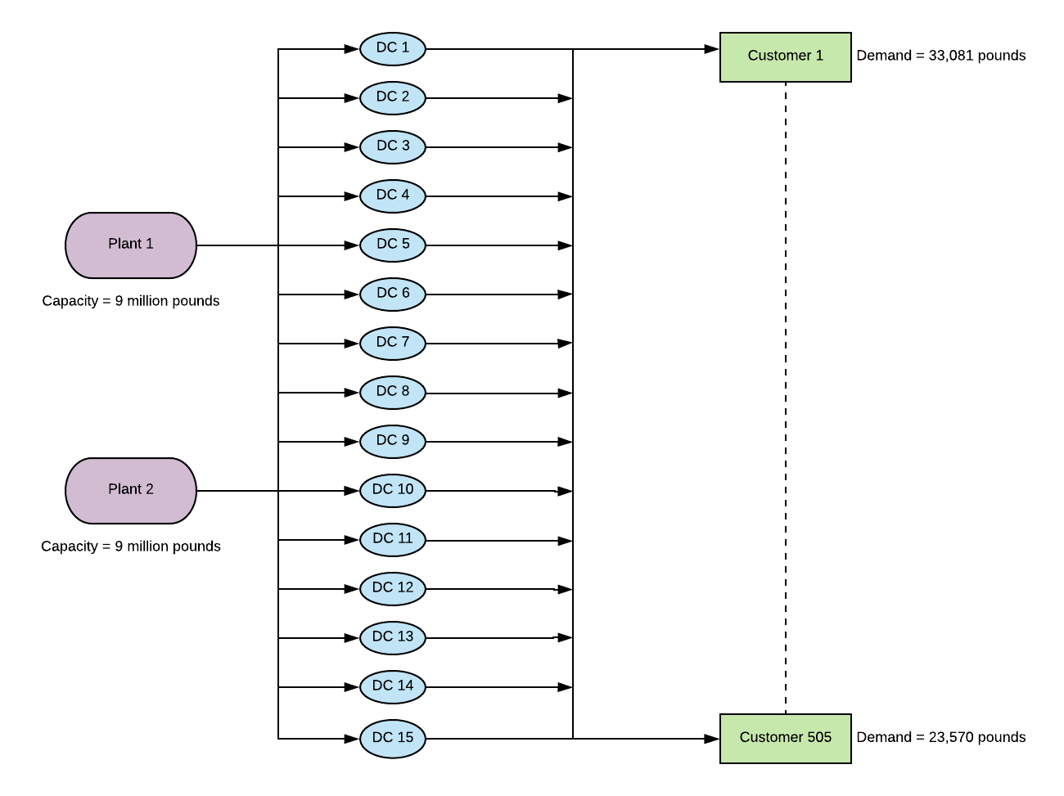
Network Diagram

Slide 3
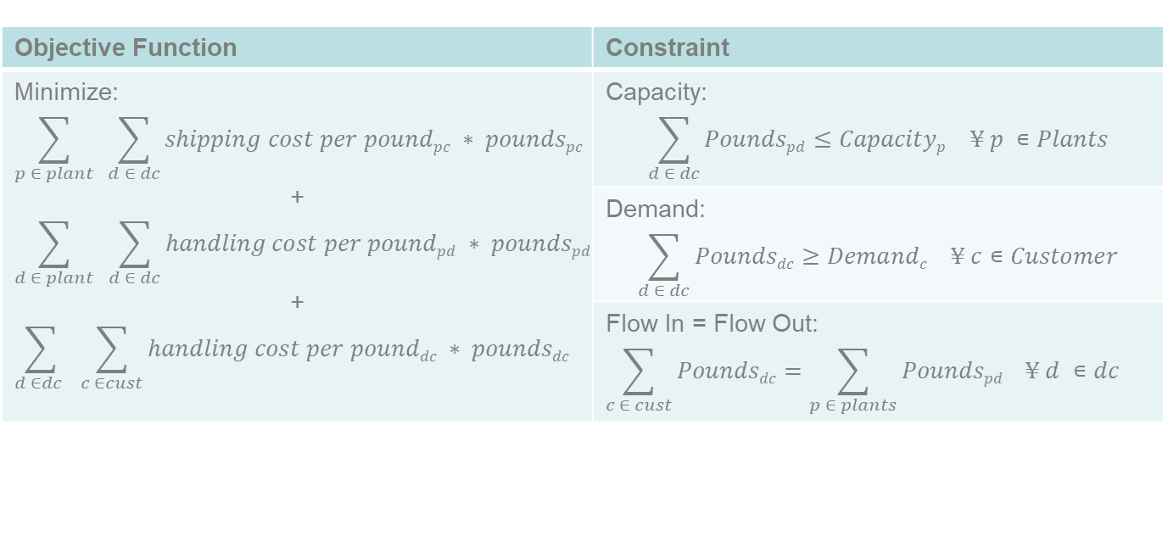
Model Formulation
Data | Decision Variables
Capacity for each plant | Pounds shipped Inbound
Demand for each customer zone | Pounds shipped Outbound
Inbound/Outbound cost per pound
Handling cost per pound
Transit Time

